Slide 1


Distributed Systems CMPE 273
Professor: Dr. Simon Shim
Project Group: 7
Sai Chaitanya Dasari 014337271
Kowshhal Uppu 014538134
Yash Trivedi 014509339
Ambika Na 014606436
Sumeet Deshpande 014608334

Slide 2
Introduction
Main Features Implemented-
CQRS split- (command query responsibility segregation) and event sourcing to the respective topic.
Redis Master-slave cluster with sentinel to backup and also load-balanced reads.
Distributed multi-broker and multi zookeeper Kafka.
Server powered by Kubernetes, to ensure easy scaling, rolling updates, and rollouts.
Content delivery network(cloud front) for edge locations and route 53 for a latency based routing.
Sequelize ORM for MySQL and mongoose ODM for MongoDB
Transactions for mysql writes.
Code commit pipelines.

Slide 3
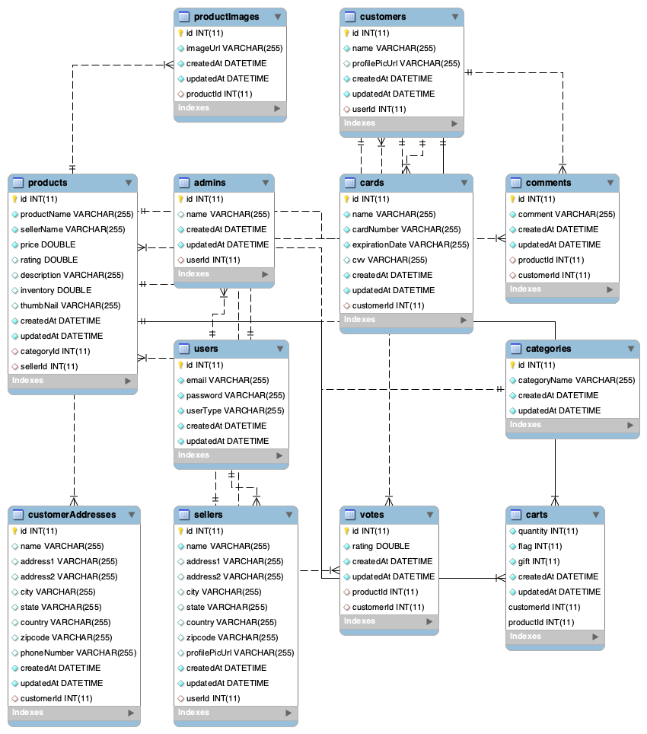
Database Schema

Slide 4
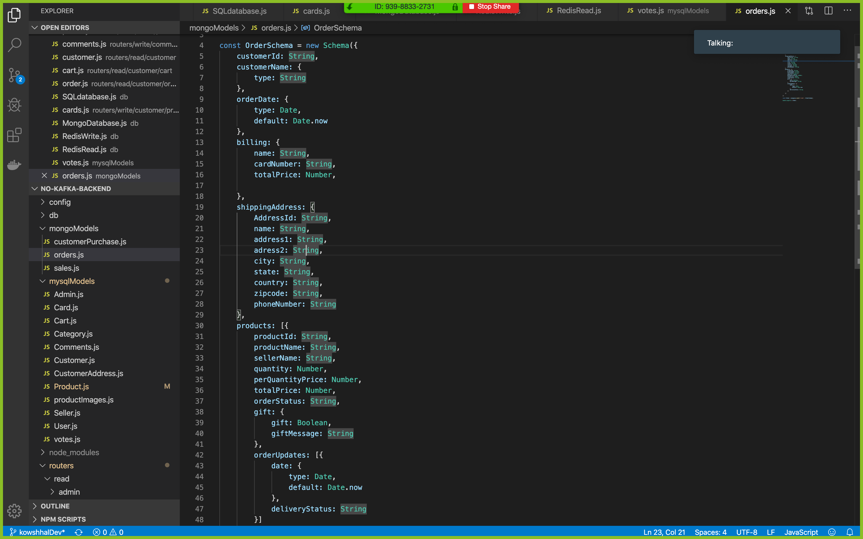
Mongo Schema

Slide 5
CAP
MYSQL- AC
MongoDB- CP
Redis - CP for writes and AP for reads
C- consistency- writes are extremely consistent, Kafka has a replication factor of 3 for writes in the case of any backend failure, we also write to the database first then update the cache, we are also implementing transactions which ensure consistency in case of any exceptions or failures.
A- availability- Reads are highly available, many elastic load balancers are used in order to ensure that reads are properly distributed, also redis reads are load-balanced, and read topics of Kafka have multiple partitions which ensure very high availability,
P- partition tolerance- This system is highly fault-tolerant and distributed, we have deployed the architecture on multiple availability zones and Kubernetes makes sure that the system is always up by scaling it to the desired replicas.

Slide 6
Cloud Architecture

Slide 7
Redis
Configuration

Slide 8
Kafka Architecture
Kafka Topics and Replication Factor

Slide 9
Load Balancer

Slide 10
API GATEWAY

Slide 11
Jmeter Graphs

Slide 17
Kubernetes 1

Slide 19
Kubernetes 3

Slide 21
Kubernetes 4

Slide 23

Thank you

